Slide 1


Pimpri Chinchwad Education Trust’s
Pimpri Chinchwad College of Engineering
YOUNG RESEARCHERS’ CONFERENCE 2025
Department of CSE (AI&ML)
AAAI Student Chapter
Research Paper Title:
Hybrid Power System Simulation and Data Acquisition for Machine
Learning-Based Performance Analysis
TRACK:
AI Driven Solutions for Sustainable Development
Tanish Raghwani
Akhul Hegde
Parth Shendkar
Mayur Patil
Guide: Puja Kate Pohakar

Slide 2
Problem Statement
While solar and wind energy are clean sources of energy, intermittent generation means they cannot be relied on to produce constant voltage and power output. The integration of solar, wind, and battery storage into a hybrid system is necessary to deliver stable, reliable, efficient, and cost-effective power supply stability.
Key Issues
Solar energy and wind energy are considered intermittent resources because they cannot provide a continuous supply on their own.
Power delivery and voltage will become unstable and quality will deteriorate with variability from renewable resources.
Remote and rural locations will experience unreliable electricity supply without hybrid renewable energy systems.
An abundance of renewable energy will be wasted due to inadequate storage.
AAAI Student Chapter: Young Researchers’ Conference 2025
PAGE NO. 1

Slide 3
System Architecture
Solar PV System
Generates DC power connected to DC bus through DC-DC boost converter for optimal energy harvesting.
Wind Energy System
Wind turbine with PMSG, rectifier, and boost converter supplying DC power to the main bus.
Battery Storage
Bidirectional DC-DC converter enabling charging and discharging based on load demand fluctuations.
AAAI Student Chapter: Young Researchers’ Conference 2025
PAGE NO. 2

Slide 4
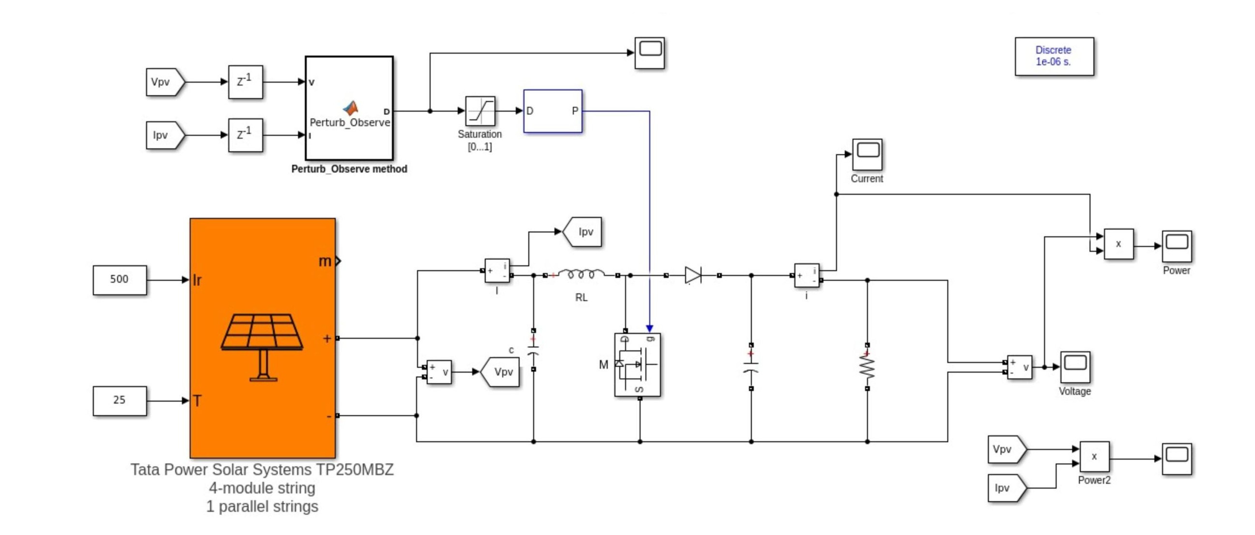
AAAI Student Chapter: Young Researchers’ Conference 2025
PAGE NO. 1

Slide 5
Solar Panel Block
The solar panel block transforms sunlight (irradiance) and temperature into DC voltage and current.
Output will depend on the weather conditions such as incoming sunlight and temperature of the panel.
DC–DC Converter: Regulates the voltage by boosting or bucking it as required. It receives control signals from the MPPT algorithm to maintain maximum power delivery.
MPPT (Perturb & Observe Algorithm) Continuously adjusts the panel’s operating point. If a small change increases power, it keeps moving in that direction; if power decreases, it reverses. This ensures the panel always works at its maximum power point.
AAAI Student Chapter: Young Researchers’ Conference 2025

Slide 6
Output Metrics (Scopes)
Records and displays voltage, current, and power over time in the form of a graph.
Shows how power climbs and stabilizes at its peak.
Shows how changes in sun light and temperature affect performance.
Overall Working
The model functions like a real solar inverter. It extracts maximum possible power from the solar panel under varying weather conditions, demonstrating how solar energy can be efficiently optimized in practice.
AAAI Student Chapter: Young Researchers’ Conference 2025
PAGE NO. 1

Slide 7
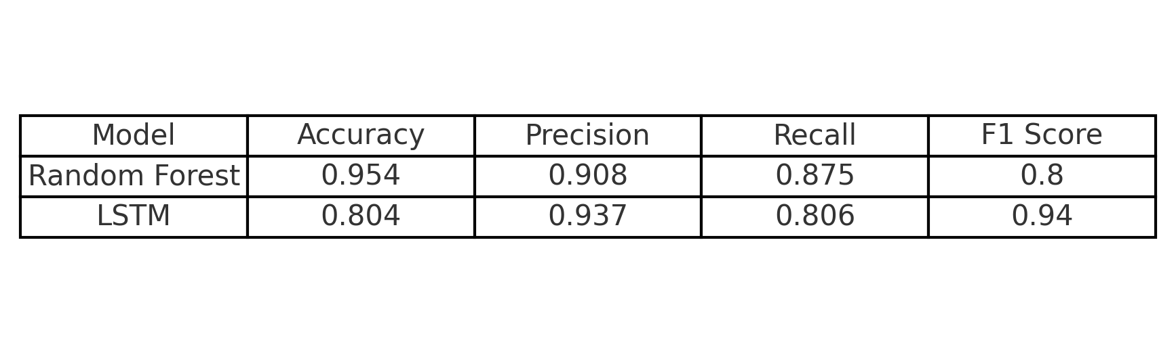
ML MODELS USED AND RESULTS
1. Random Forest: Random Forest will look at inputs like irradiance, temperature and predict the power output. 2. LSTM (Long Short Term Memory): Normal models may forget yesterday’s weather, but LSTM can remember patterns over days, weeks, or months. LSTM can use past weather and power data to forecast future solar power.
We are using NASA Power API to get datasets of irradiance and temperature and we use regression models like Random Forest and LSTM to predict solar power from weather data. Once we know the expected power output, we can use if for panel type suggestions, and panel planning, investment decisions for companies and energy management to estimate solar power.
AAAI Student Chapter: Young Researchers’ Conference 2025
PAGE NO. 1

Slide 8
Future Scope
Application in rural and remote areas for reliable power supply
Integration with IoT for real-time monitoring and control
Integration With Smart Grids
Potential to scale up for industrial and urban applications
AAAI Student Chapter: Young Researchers’ Conference 2025
PAGE NO. 1

Slide 9
Conclusion
A hybrid energy system combining solar PV, wind energy, and battery storage has been effectively modeled and simulated using MATLAB/Simulink. The hybrid energy system shows reliable voltage regulation, consistent supply of energy to the load, and optimal utilization of renewable sources.
Future research may include the addition of other sources such as fuel cells or electrolyzers, and cost and reliability analysis of the system in a practical environment.
AAAI Student Chapter: Young Researchers’ Conference 2025
PAGE NO. 8

